Slide 1
Prompt Engineering
Unleashing the Power of Gen AI

Slide 2
Agenda
In this session, we’ll discuss:
Introduction to Generative AI and LLMs
Basics of Prompt Engineering
Components of a Good Prompt
How to Write a Prompt?
Advanced Prompt Strategies
Common Prompting Errors
Limitations of Generative Models
Applications of Prompt Engineering

Slide 3



Introduction to Generative AI (Gen AI)
Generative AI (Gen AI) refers to Artificial Intelligence that can generate content — be it text, images, or code — based on the input it receives from the user.

Slide 4
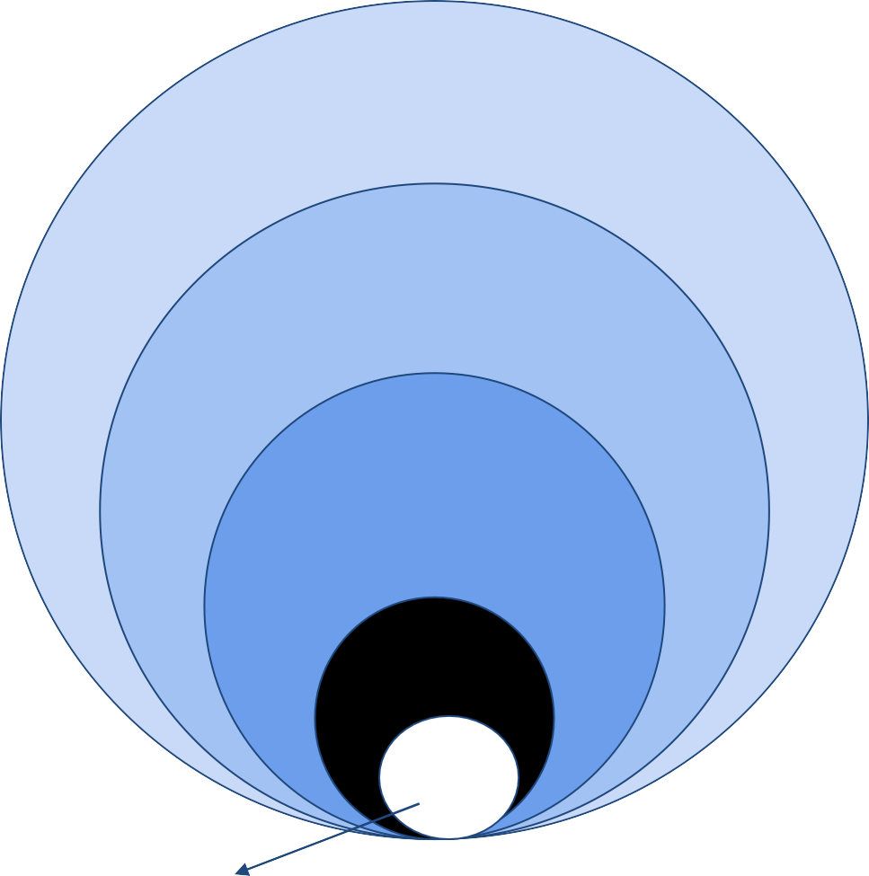
Understanding Gen AI
Artificial Intelligence
Machine Learning
Deep Learning
Gen AI
LLM
^{ChatGPT is here}.

Slide 5
Introduction to Large Language Models (LLMs)
What are LLMs?
Large – as it is trained on large amounts of data and billions of trainable parameters.
Language – as it deals with text data.
Model – as it predicts the next word/sentence/token.
LLMs are language models made up of a neural network with billions of parameters that are trained by self-supervised learning on vast amounts of unlabeled text.
Base LLMs
Foundational LLMs like GPT-3
LLMs
Instruction- based LLMs
Task-specific models following provided directives

Slide 6
Introduction to Large Language Models (LLMs)
How do LLMs work?
Input
LLMs
Tasks
Text
Generative Models
Text Summarization
Sentiment Analysis
Question Answering
Information Extraction
Text Translation
Pre-training
Fine-tuning

Slide 7




Popular LLMs
GPT by OpenAI
Mistral by OpenAI
Gemini by Google
Llama by Meta

Slide 8

Basics of Prompt Engineering
Prompt engineering is as much an art as it is a science.
Idea
Prompt: A detailed set of guidelines given to an LLM to do a task.
Engineering: Developing a task-specific prompt iteratively.
Test or Feedback
Prompt
Prompt Engineering is an iterative process.
Results

Slide 9
Basics of Prompt Engineering
Prompts
1
2
Parameters
Structure
Temperature: Lower for creativity and deterministic results; Higher for diversity and factual QA.
Top P: Control model determinism; Low for factual, high for diverse.
Max Length: Manage response length.

Slide 10
Let’s write a few prompts!!

Slide 11
Components of a Good Prompt
Context
Instruction
external information or
Additional context that can steer the model to better responses.
A specific task or instruction you want the model to perform.
Input Data
Output Indicator
The input or question that we are interested in finding a response for.
The type or format of the output.

Slide 12
Components of a Good Prompt
Context
external information or
Context
Additional context that can steer the model to better responses.
Act as an analyst working for an OTT platform. You will have to perform sentiment analysis based on the feedback provided by the consumers on the movies and series put on the OTT platform.

Slide 13
Components of a Good Prompt
Context
Instruction
Instruction
external information or
Additional context that can steer the model to better responses.
A specific task or instruction you want the model to perform.
Classify the feedback as neutral, negative, or positive, where positive is promotor; negative means demoter, and neutral means neither will promote nor demote the content.

Slide 14
Components of a Good Prompt
Context
Instruction
Example
Feedback: I think the series was okay. Sentiment: Neutral
Feedback: The acting of each character in the
series was awesome. Sentiment: Positive
external information or
Additional context that can steer the model to better responses.
A specific task or instruction you want the model to perform.
Input Data and Output Indicator Feedback: The storyline for the series was repetitive and abysmal.
Sentiment:
Input Data
Output Indicator
The input or question that we are interested in finding a response for.
The type or format of the output.

Slide 15
Components of a Good Prompt
Context Instruction
Example
Feedback: I think the series was okay. Sentiment: Neutral
Feedback: The acting of each character in the series was awesome.
Sentiment: Positive
Input Data and Output Indicator Feedback: The storyline for the series was repetitive and abysmal.
Sentiment:
Act as an analyst working for an OTT platform. You will have to perform sentiment analysis based on the feedback provided by the consumers on the movies and series put on the OTT platform.
Classify the feedback as neutral, negative, or positive, where positive is promotor; negative means demoter, and neutral means neither will promote nor demote the content.
Negative

Slide 16
How to Write a Good Prompt?
Here’s a checklist, to create the most effective prompt and get the best results.
Define the Goal – Tell ChatGPT what you exactly want it to do.
Detail out the Format – Specify the format in which you want your output. E.g., tables/paragraphs/lists, with or without a heading, listed in priority order if any, etc.
Create a Role – Assign ChatGPT a role to let it process your request from that specific point of view. E.g., Act as X.
Clarify who the Audience is – Specify the demographics for ChatGPT to help it tailor its response appropriately.
Give Context – Provide every possible information to ChatGPT to help it understand the purpose of your request.

Slide 17
How to Write a Good Prompt?
Here’s a checklist, to create the most effective prompt and get the best results.
Give Examples – Share examples to let ChatGPT learn from it and produce more accurate results.
Specify the Style – Outline the tone, the communication style, the brand identity and other details in your prompt for a suitable response.
Define the Scope – Outlining a scope with further specifications besides giving a context and examples, will help ChatGPT operate within those parameters.
Apply Restrictions – Constraints or restrictions applied in your prompt will create the right boundaries for ChatGPT to produce more relevant responses.

Slide 18
Different Prompt Patterns
What are some of the most common Prompt Patterns?
Persona Pattern - Act as X. Do the task Y. (E.g., As a Yoga instructor, create a beginner-friendly routine for joint mobility.)
Audience Persona Pattern - Explain X to me. Assume I’m Y. (E.g., Explain the importance of eating greens. Assume I’m a skeptical child.)
Visualization Generator Pattern - Generate X that can be provided to tool Y for visualization. (E.g., While talking about the data around user engagement metrics on certain website, generate a CSV that I can use in Tableau to create a visualization.)

Slide 19
Different Prompt Patterns
What are some of the most common Prompt Patterns?
Recipe Pattern - In order to do X, I need to perform steps a, b, c. Provide a complete sequence of steps for me while filling in any missing steps and removing redundant steps. (Eg: I want to travel from Bangalore to Darjeeling. I know I have to take a flight to Kolkata. And from there take train and a cab to Darjeeling. Complete the itinerary for me)
Template Pattern - I will provide a template, with placeholders for content. Fit the output with one or more placeholders that I list.
Eg: Generate a day-wise travel itinerary for visiting Paris. My placeholders are -
❏ <Day> for the day of the travel plan
❏ <Location> for the place to visit
❏ <Activity> for what to do in that place
❏ <Time> for the best part of the day to visit
Template: For <Day> visit <Location> at <Time> for <Activity>

Slide 20
Examples

Slide 21
Advanced Prompt Strategies
Here’s a few instances of advanced prompt strategies:
Zero-Shot Learning - Directly instructing the model to perform a task without any additional examples.
Few-Shot Learning – Teaching with examples in the prompt.
Chain of Thought Process – Asking to show its work or thought process.

Slide 22
Common Prompting Errors
Vague or Ambiguous Prompts
Biased Prompts
Lack of Contextual Information
Insufficient Examples or Training Data
Complex or Confusing Prompts
Not testing prompts thoroughly

Slide 23
Limitations of Generative Models
Hallucinations - produce imaginative and surreal responses
Token length - tokens available 4096 tokens for input & 2048 for output
Pricing - for better versions / increase in token size
Resource Intensive - computationally expensive and resource-intensive

Slide 24
Applications of Prompt Engineering
Content Generation
Customer Support and Engagement
Data Analysis and Science
Copywriting and Advertising
Creative Writing
Educational Content
Chatbots and Virtual
Assistants
Instructional Guides
Data Cleaning and
Preparation
Statistical Analysis and
Visualization
Code Generation and Software Development
Research and Information Retrieval
Automating Code Writing
Debugging Assistance
Documentation Generation
Text Summarization
Question Answering

Slide 25
Applications of Prompt Engineering
Machine Translation
Sentiment Analysis
Other Domains
Information Sharing
Internal Communication
Consumer Feedback Analysis
Brand Management
Marketing
Healthcare
Manufacturing
Security
Retail and Shopping

Slide 26
Summary
Here’s a brief recap:
The key to becoming a proficient prompt engineer is practice.
Experiment with different prompts.
Analyze the outcomes.
Refine your techniques.
Keep practicing, stay curious, and explore various AI platforms to enhance your skills.

